Slide 1
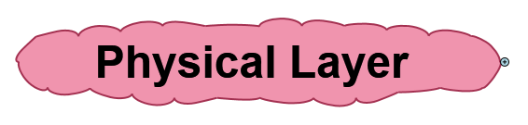

Slide 2
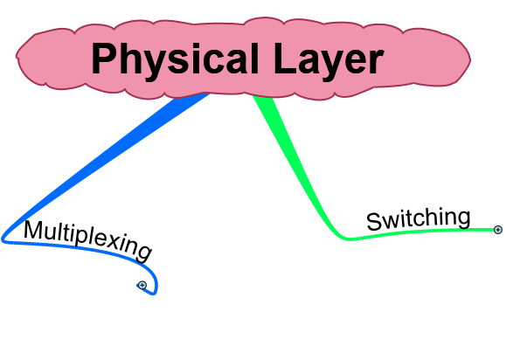

Slide 3
What is Multiplexing
Multiplexing (or muxing) is a way of sending multiple signals or streams of information over a communications link at the same time in the form of a single, complex signal.

Slide 4
Multiplexing vs. No Multiplexing

Slide 5
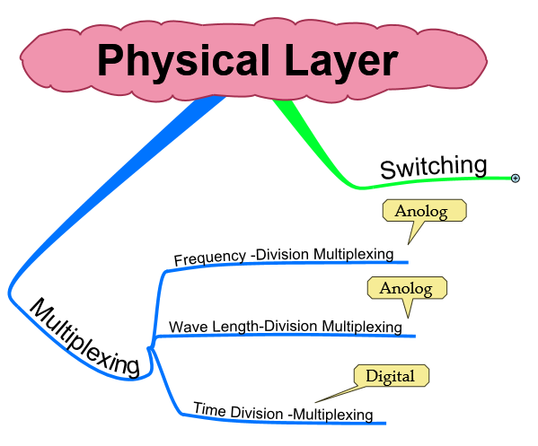

Slide 6
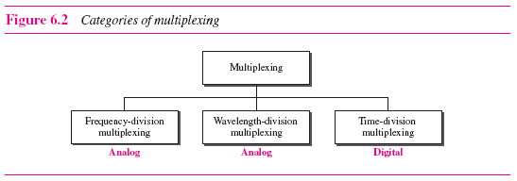

Slide 7
Frequency Division Multiplexing

Slide 8
FDM, Time Domain

Slide 9
Demultiplexing, Time Domain

Slide 10
Figure 8-7
Demultiplexing, Frequency Domain

Slide 11
Time Division Multiplexing

Slide 12
Synchronous TDM

Slide 13
TDM, Multiplexing

Slide 14
TDM, Demultiplexing

Slide 15
Asynchronous TDM

Slide 16
Multiplexing and Inverse Multiplexing

Slide 17
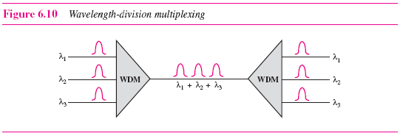

Slide 18
